Slide 1


Employer MyBenefits Portal Tutorial
Send Feedback

Slide 2
Before You Begin
2 of 13
Helpful Tip
Using the Send Feedback feature provides a secure way to communicate with EASI Edu and helps keep all employee-related correspondence in one location.
Before sending feedback, please review the following information:
The Send Feedback feature can be used at any time during the year.
Securely send confidential employee information and supporting documents through the Employer Portal.
Messages are securely delivered to EASI Edu.
All messages are stored within the Employer Portal for future reference.
There is no limit to the number of messages or documents you can submit.

Slide 3
Before You Begin
3 of 13
You must be logged into the NMPSIA MyBenefits Portal before
completing this tutorial.
If you are a new user, forgot your password, or experience login issues, please refer to the Employer Login Tutorial https://nmpsia.com/employer-trainings.html for complete step-by-step instructions.
Important Reminders
• MFA codes expire after 5 minutes.
• Use the email associated with your NMPSIA benefits.
• Check your Spam or Junk folder if you do not receive your code.
Need help logging in?
Please refer to the Employer Login Tutorial before continuing.
The Employer Login Tutorial includes:
✔ First-Time Login
✔ Password Assistance
✔ MFA Verification
✔ Common Login Errors
✔ Account Assistance
Helpful Tip
Bookmark the Employer Portal login page for quicker access in the future.
Go to NMPSIA.com
↓
Benefits Portal Login
↓
Select Employer
↓
Enter District ID
↓
Select Representative
↓
Enter Password
↓
Complete MFA Verification

Slide 4
What You'll Need
4 of 13
Before beginning, have the following information available:
District ID
Your login credentials
Access to your authentication email
Employee's Social Security Number (SSN), Name, or HIPAA ID
Documents you would like to attach (if applicable)
Subject for your message
Description of your question or request
Helpful Tip
Providing a clear subject and detailed message will help your EASI Edu Representative respond more quickly.

Slide 5
Transaction Overview
5 of 13
Helpful Tip
The Send Feedback feature provides a secure record of all communication between your organization and EASI Edu.
This tutorial will show you how to:
✔ Search for an employee
✔ Send a secure message
✔ Attach supporting documents
✔ View previous messages and responses
✔ Track the status of your communications

Slide 6
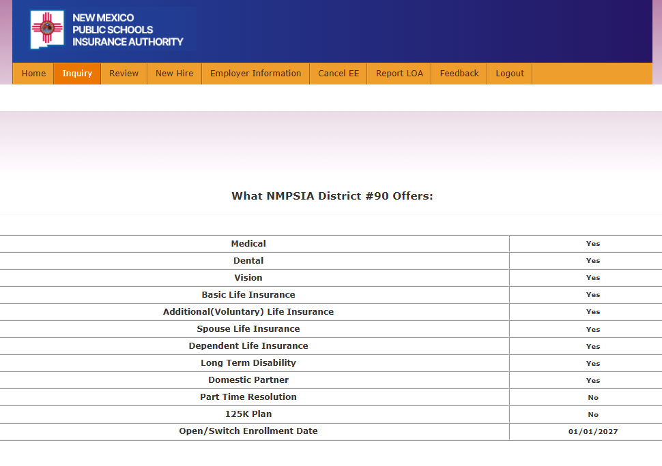
Step 1
6 of 13
From the Home page
Navigate to the Inquiry tab.
Helpful Tip
The Inquiry page allows you to search for an employee before sending secure messages or reviewing employee information.

Slide 7
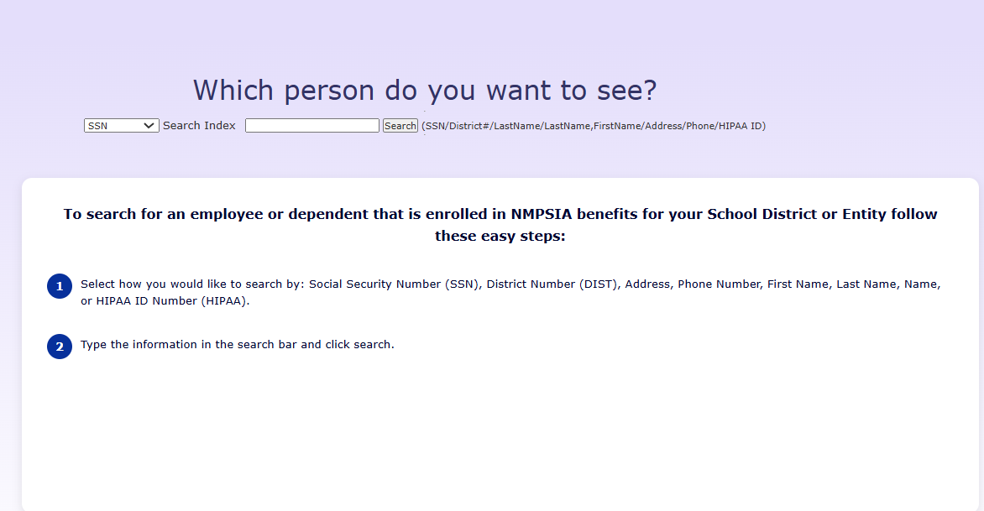
Step 2
7 of 13
Search for an Employee
Select your preferred search method (SSN, Name, HIPAA ID, etc.).
Enter the employee's information.
Select Search.
1.
2.
3.
Helpful Tip
Searching by Social Security Number usually provides the quickest and most accurate results.

Slide 8
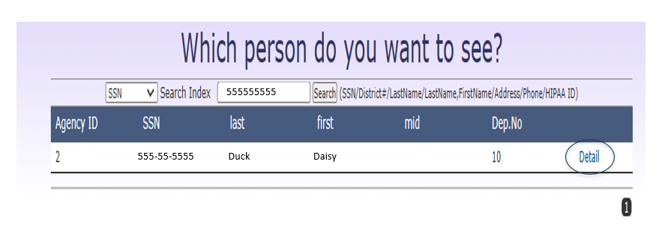
Step 3
8 of 13
Verify the employee's information.
Select Detail to open the employee's record.
Helpful Tip
Always verify you have selected the correct employee before sending confidential information.

Slide 9
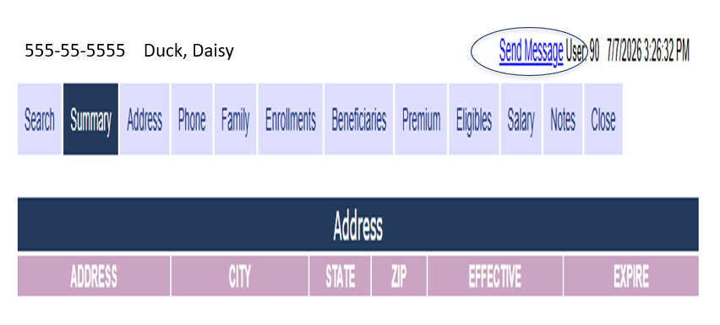
Step 4
9 of 13
From the employee's record:
Select Send Message.
Helpful Tip
Use Send Message whenever you need to securely communicate with EASI Edu regarding an employee's benefits.

Slide 10
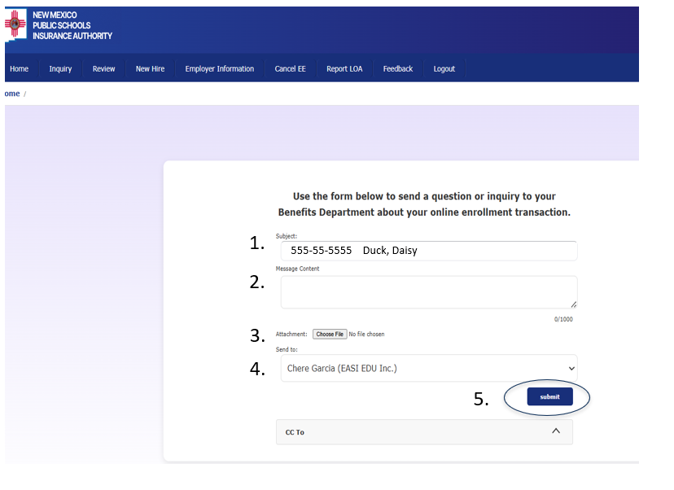
Step 5
10 of 13
Subject will auto populate with employee name and SSN.
Type your message.
Attach supporting documents, if needed.
Select the appropriate recipient.
Select Submit.
Helpful Tip
Include enough detail in your message to help your EASI Edu Representative understand your request without requiring additional follow-up.

Slide 11
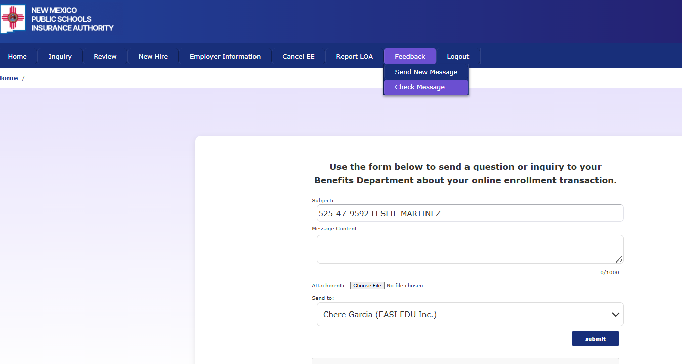
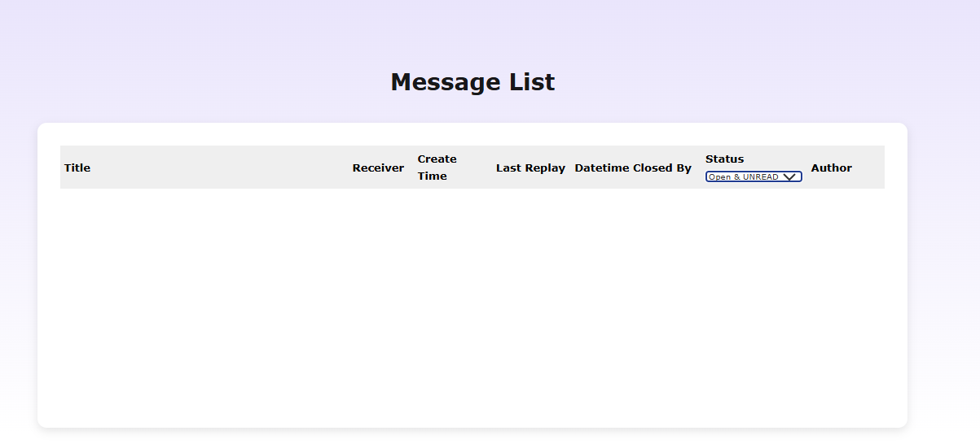
Step 6
11 of 13
To review previously submitted messages from the Home page:
Navigate to the Feedback tab.
Select Check Message.
Select Open & Unread or Closed to filter messages.
Open messages to review responses from your EASI Edu Representative.
555555555 Duck,Daisy
Helpful Tip
Review your message history before sending a new request. Your question may have already been answered within an existing conversation.

Slide 12
Common Errors
12 of 13
Common issues you may encounter
when sending feedback:
Employee not found – Verify the employee's Social Security Number (SSN), Name, or HIPAA ID and search again.
Required fields are incomplete – Complete the subject and message before submitting.
Attachment failed to upload – Verify the file is supported and has finished uploading before selecting Submit.
Message sent to the wrong recipient – Confirm the appropriate recipient before submitting your message.
Authentication code expired – Request a new Multi-Factor Authentication (MFA) code and sign in again.
Session timed out – Log back into the Employer Portal and restart your request.
Unable to locate previous messages – Verify you selected the correct message status (Open & Unread or Closed) or adjust your search criteria.
Helpful Tip
Before submitting your message, review the employee information, subject, attachments, and recipient to ensure everything is accurate.

Slide 13
Need Assistance
13 of 13
Thank you for supporting your employees!
Contact Us:
EASI Edu
Phone: 1-800-233-3164
Contact your assigned representative for portal assistance.
Or
NMPSIA Benefits Team
Phone: 1-800-548-3724

